Slide 1

A Neural Framework for Sandhi Splitting in
Low-Resource Sanskrit Texts
Guided by,
Jayashree Nair
Abhiram A S AM.EN.U4AIE22002
Karthik Narayan C AM.EN.U4AIE22028
Harigovind C B AM.EN.U4AIE22119

Slide 2
Outline
Introduction
Problem Definition
Objectives
Literature Review Summary(Table)
Research Gap
Dataset Description
Methodology / Proposed Method
Design/ Architecture
Algorithms (if any)
Evaluation Metrics
Result Analysis
Alignment with SDG Goals
Limitations
Future Works
Publications
Reference(APA style)
Project title

Slide 3
Introduction
Sanskrit preserves India’s rich literary, philosophical, and medical heritage (Charaka Samhita, Sushruta Samhita).
Sandhi = phonological merging of word boundaries
Over 10,000+ Ayurvedic verses digitized → growing demand for automated NLP tools.
Sandhi splitting = the inverse task: recovering original lexical units from compound words. Critical pre-processing step for parsing, machine translation, semantic analysis, and information retrieval.
Project title

Slide 4
Problem Definition
Existing Sandhi splitters fail on Ayurvedic Sanskrit:
Ambiguity — multiple valid lexical decompositions per compound.
Long compounds (samasa) — accuracy collapses on 4+ morpheme boundaries.
No neural–linguistic synergy — rule-based and ML models treated as silos.
OOV vocabulary — domain-specific Ayurvedic terms unseen by general models.
Limited evaluation rigor — no structured error analysis, ablations, or failure taxonomy.
Existing tools achieve < 70% accuracy on Ayurvedic texts.
Need: a unified, domain-aware, hybrid neural-linguistic framework.
Project title

Slide 5
Objectives
Primary Objectives
O1 — Benchmark: Rule-based, BiLSTM, Seq2Seq+Attention,Transformers (mT5, ByT5, UMT5, IndicBART).
O2 — Analyse: Structured error analysis & domain-specific failure taxonomy.
O3 — Design: Hybrid neural-linguistic pipeline with Paninian rule support and candidate ranking.
O4 — Evaluate: Ablation experiments using Accuracy, F1, Exact Match, CER.
Secondary Objectives
O5 — Optimise: Lightweight pipeline for standard research hardware.
O6 — Domain Evaluation: UoH Charaka Samhita corpus benchmark
Project title

Slide 6
Literature Review Summary
Authors | Year | Method | Research Gap
Aralikatte et al. | 2018 | Seq2(Seq) Pointer Net | Fails on long compounds
Reddy et al. | 2018 | Seq2Seq + Attention | No domain evaluation
Hellwig et al. | 2019 | Neural splitting | No lexical reconstruction
Dave et al. | 2020 | Joint generation + split | Computationally expensive
Sen et al. | 2022 | ByT5 (byte-level) | No linguistic constraints
Kakwani et al. | 2022 | IndicBART | Not task-specific
Sandhan et al. | 2023 | mT5 / SanskritShala | Limited domain adaptation
Varshini Nair | 2023 | Ayurveda-specific NLP | No proposed solution
Sreedeepa et al. | 2024 | DL Review | No novel method
Bhat Premjith | 2025 | Transformer (semantics) | Not splitting
Project title

Slide 7
Research Gap
Phase I gaps addressed
No neural baselines for Ayurvedic Sanskrit → established.
No two-stage pipeline → boundary detection + lexical restoration.
Aggregate metrics only → confusion matrices + failure taxonomy.
Phase II gaps addressed
No transformer fine-tuning on Ayurvedic → mT5, ByT5, UMT5, IndicBART.
No neural-linguistic integration → Hybrid pipeline (Paninian +ByT5).
No tokenizer benchmark → Char vs SentencePiece vs BPE.
Heavy hardware dependency → Lightweight reproducible pipeline.
Project title

Slide 8
Dataset Description
Kaggle Sandhi Dataset
Publicly available Sanskrit compound–split corpus
Covers Vowel, Consonant, and Visarga Sandhi types
Contains approximately 13K–15K samples in Devanagari script
Used for model training and benchmarking
UoH Charaka Samhita Dataset
Derived from digitized Ayurvedic Sanskrit texts
Manually annotated and converted into structured CSV format
Used for domain-specific evaluation and validation
Captures authentic Ayurvedic vocabulary and compound patterns
Total Dataset Size: ~13,000 samples
Split Ratio: 80 : 10 : 10
Project title

Slide 9
Methodology – Phase II
Phase II – Transformer Fine-Tuning
Fine-tuning of:
mT5
ByT5
UMT5
IndicBART
Gemma-3-4B (QLoRA)
Domain-specific training using:
Kaggle Sandhi Dataset
UoH Charaka Samhita Dataset
Project title

Slide 10
Methodology – Phase I
Phase II – Two-Stage Neural Pipeline
Preprocessing
Unicode normalization
Character-level tokenization
Ayurvedic corpus cleaning
Boundary Detection
BiLSTM-based sequence labeling
Identification of Sandhi split positions
Lexical Restoration
Seq2Seq + Attention mechanism
Reconstruction of original lexical units
Project title

Slide 11
Methodology – Phase II
Hybrid Neural-Linguistic Framework
Integration of:
Transformer predictions
Paninian linguistic rules
Candidate ranking mechanism
Improved:
Ambiguity resolution
OOV handling
Long compound splitting
Project title

Slide 12
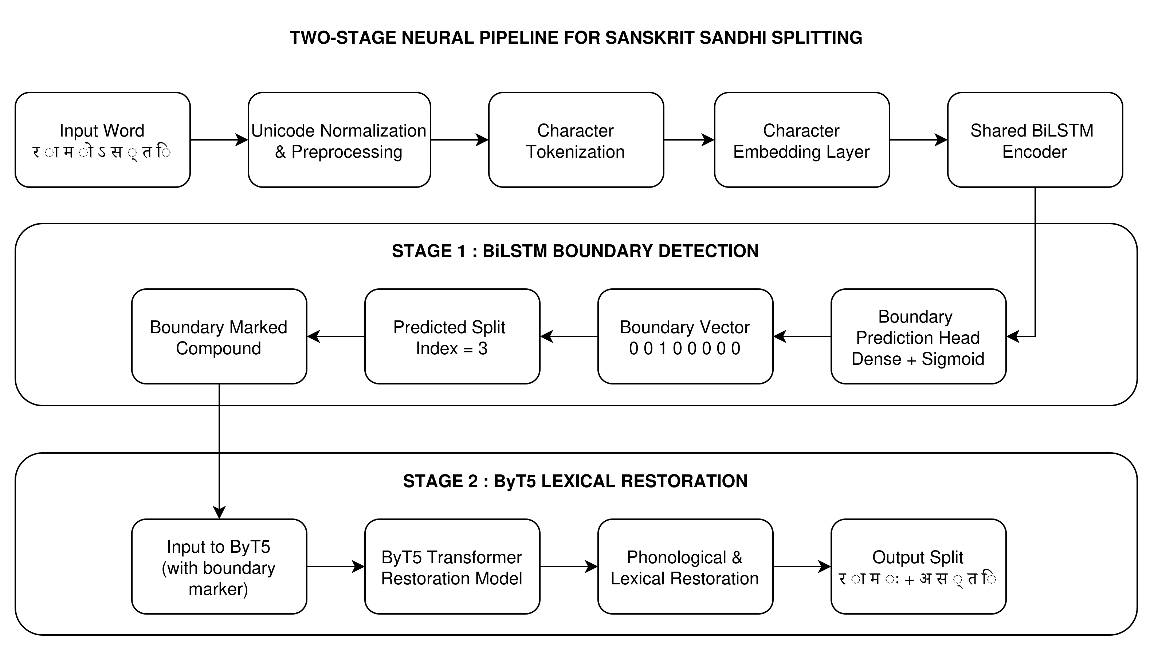
Architecture Diagram
Project title

Slide 13
Evaluation Metrics
Precision: quality of boundary predictions.
Recall: boundary coverage.
F1-Score: balanced measure.
Exact Match (EM): % outputs matching ground truth fully.
Character Error Rate (CER): char-level edit distance.
ब्रह्मदक्षाश्विदेवेशभरद्वाजपुनर्वसु-हुताशवेशचरकप्रभृतिभ्यो नमो नमः,
बरह्मदक्ष+अश्विदेवेशभरद्वाजपुनर्वसुहुताशवेशचरकप्रभृतिभ्यः+नमः नम नम नमः
Project title

Slide 14
Result Analysis
Rule-based systems achieved the lowest performance due to poor handling of ambiguity and long compound words.
Neural architectures such as BiLSTM and Seq2Seq significantly improved F1-score and Exact Match accuracy.
Seq2Seq with Attention outperformed standard Seq2Seq by improving contextual lexical restoration.
The Proposed Phase-I Pipeline achieved better balance across all metrics with an F1-score of 0.826 and reduced CER of 0.23.
Transformer-based models demonstrated strong contextual understanding and better domain adaptation for Ayurvedic Sanskrit.
The Hybrid Pipeline achieved the best overall performance with:
F1-score: 0.88
Exact Match: 0.78
CER: 0.12
Accuracy: 84%
Project title

Slide 15
Tokenizer Analysis
Tokenizer | Temp | Top-k | Perplexity | BLEU | Assessment
Character | 1.0 | 30 | 6.1998 | 0.2096 | moderate
Character | 0.8 | 20 | 5.9516 | 0.2485 | Best BLEU
Character | 0.7 | 10 | 6.2554 | 0.2218 | Good
SentencePiece | 1.0 | 30 | 57.8897 | 0.2354 | unstable perplexity
SentencePiece | 0.8 | 20 | 47.7948 | 0.2352 | Moderate
SentencePiece | 0.7 | 10 | 73.9025 | 0.1515 | worst perplexity
Tiktoken | 1.0 | 30 | 3.6344 | 0.1588 | low perplexity
Tiktoken | 0.8 | 20 | 3.4948 | 0.2098 | Best Perplexity
Tiktoken | 0.7 | 10 | 3.9484 | 0.1658 | consistent
Project title

Slide 16
Tokenizer Analysis
Tokenizer | Perplexity | BLEU Score | Overall Performance | Suitability
Character-level | Lowest | Highest | Best | Highly Suitable
SentencePiece | Moderate | Moderate | Average | Moderately Suitable
Tiktoken (BPE) | Highest | Lowest | Worst | Not Suitable
Project title

Slide 17
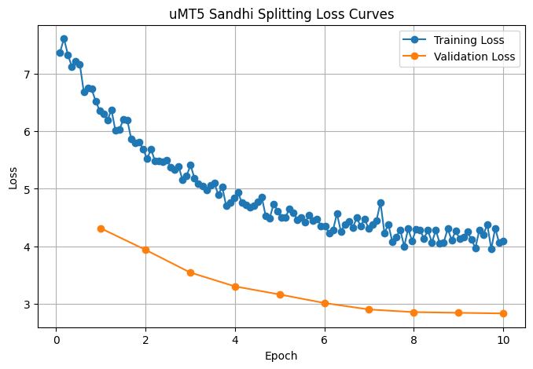
UMT5
Project title

Slide 18
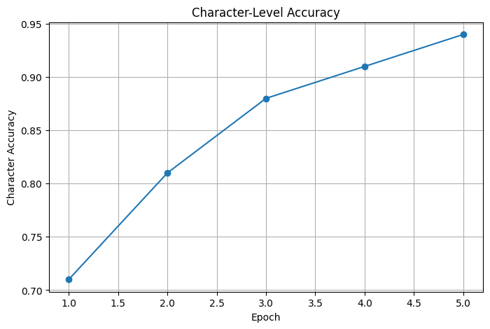
UMT5
Project title

Slide 19
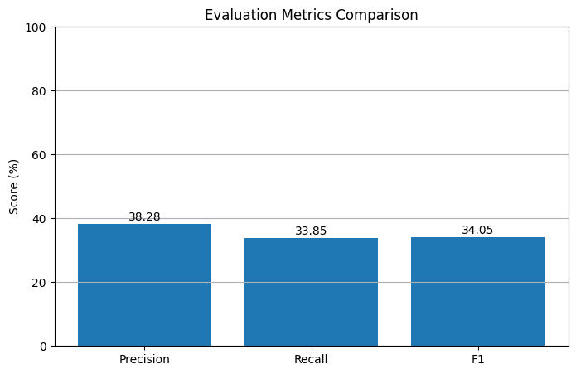
UMT5
Project title

Slide 20
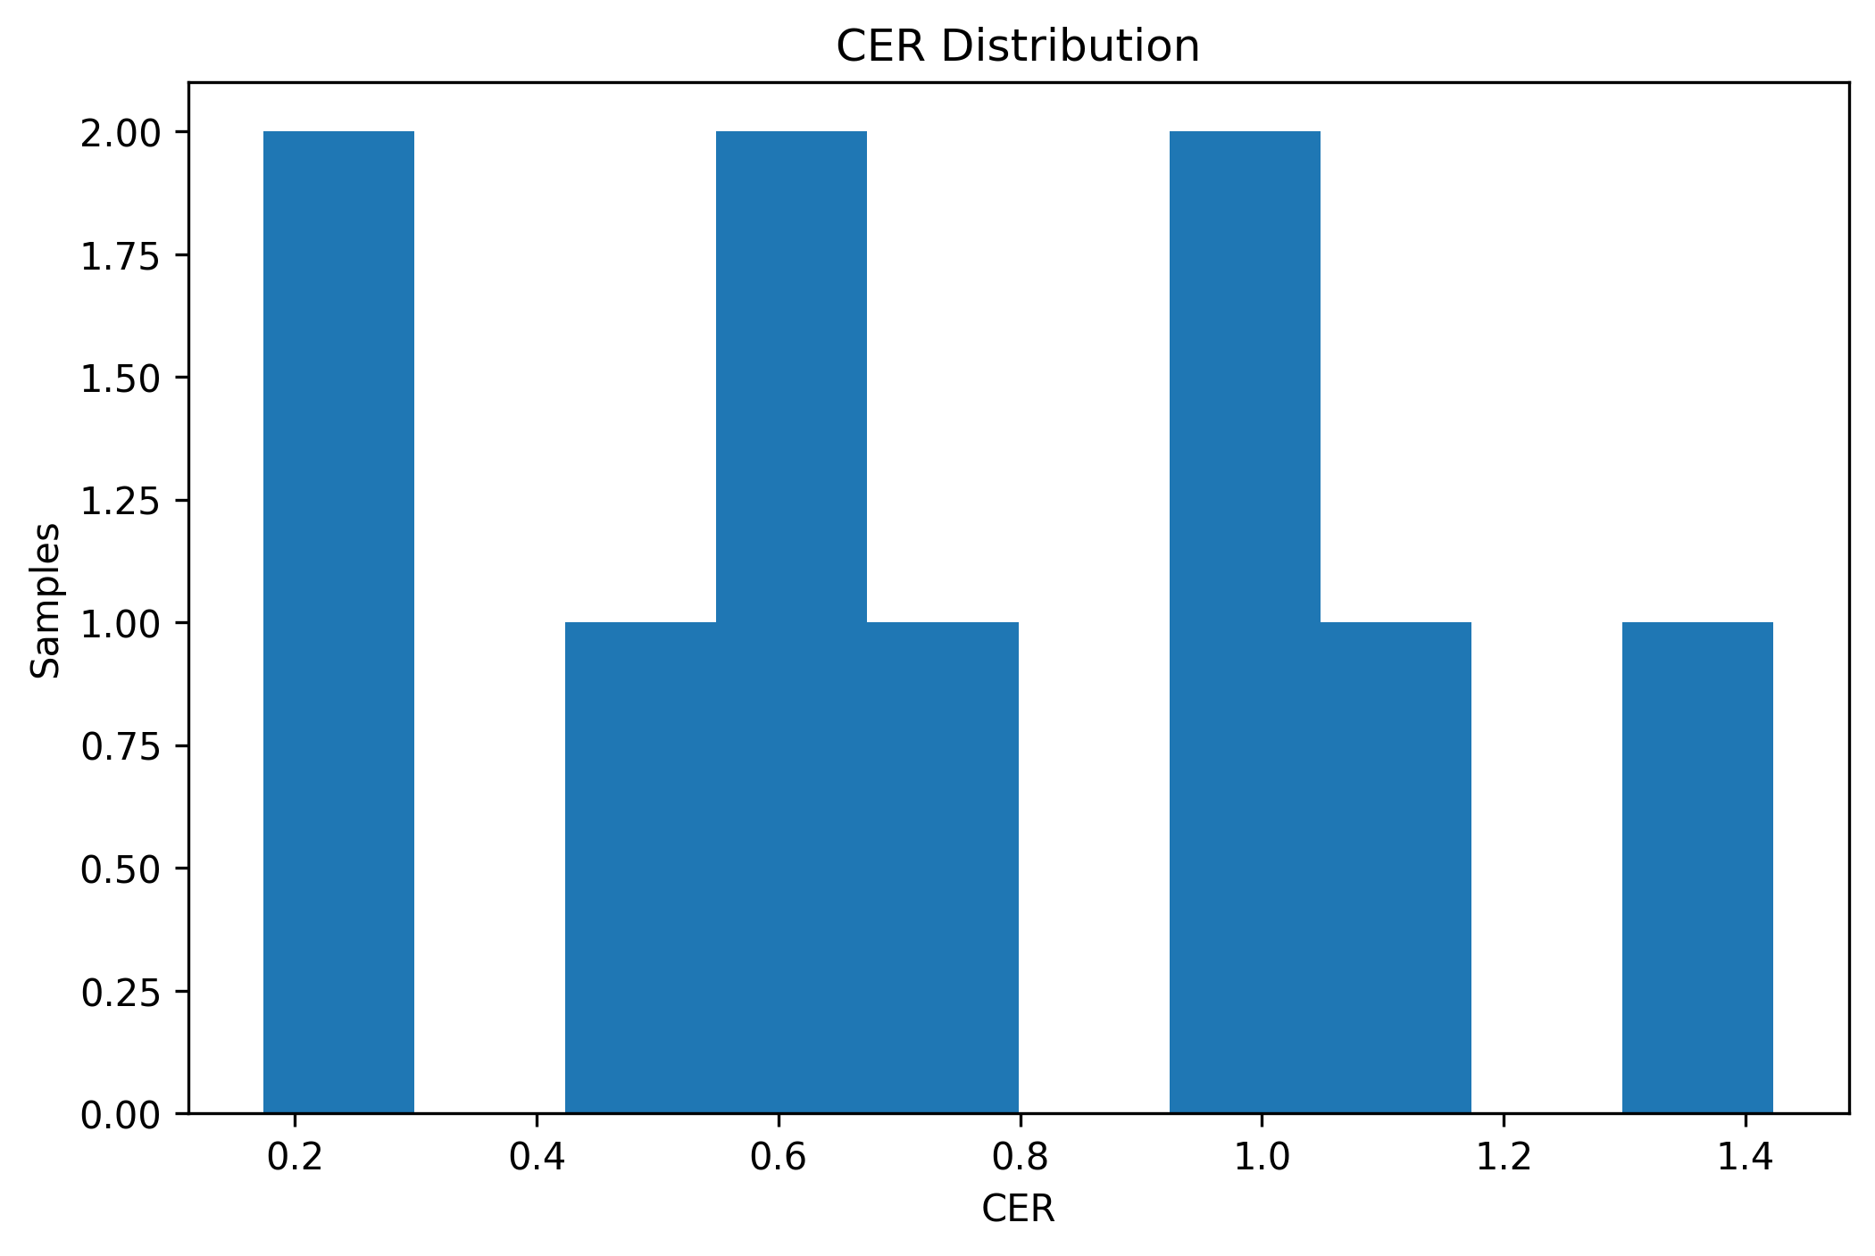
Gemma 3 4B-it
Project title

Slide 21
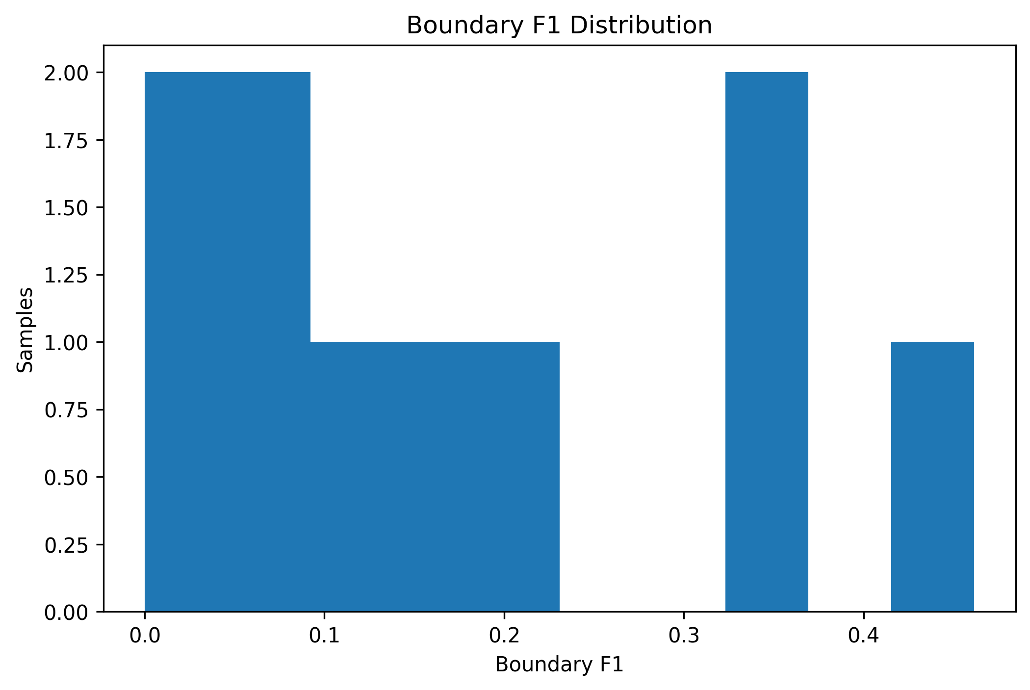
Gemma 3 4B-it
Project title

Slide 22
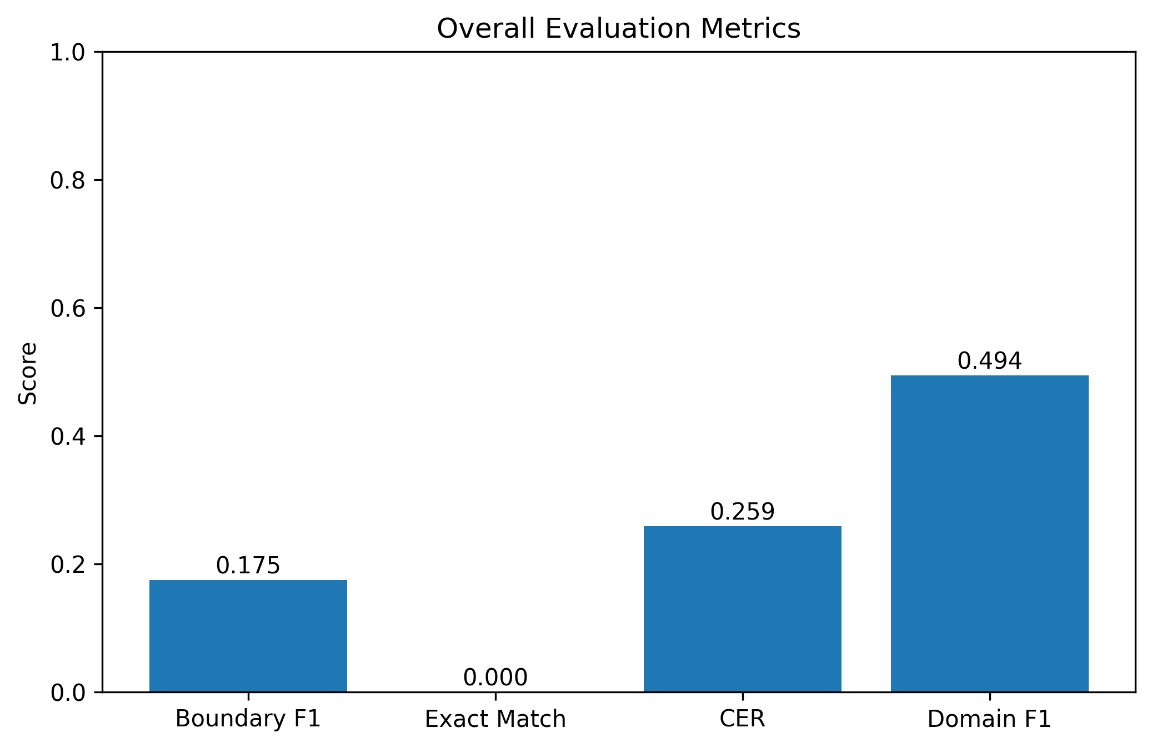
Gemma 3 4B-it
Project title

Slide 23
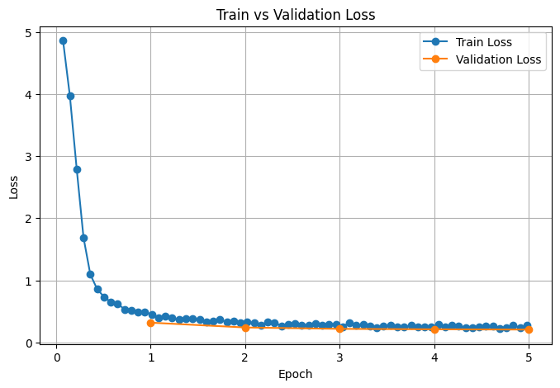
Hybrid Pipeline
Project title

Slide 24
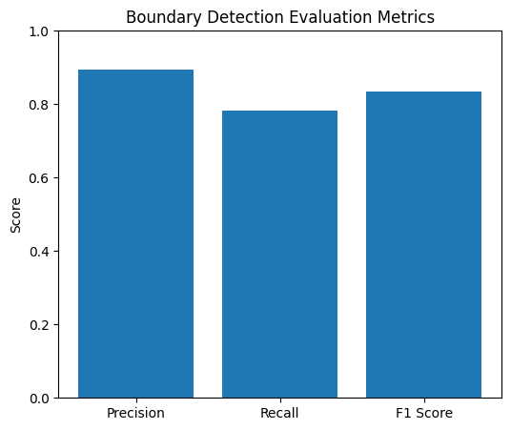
Hybrid Pipeline
Project title

Slide 25
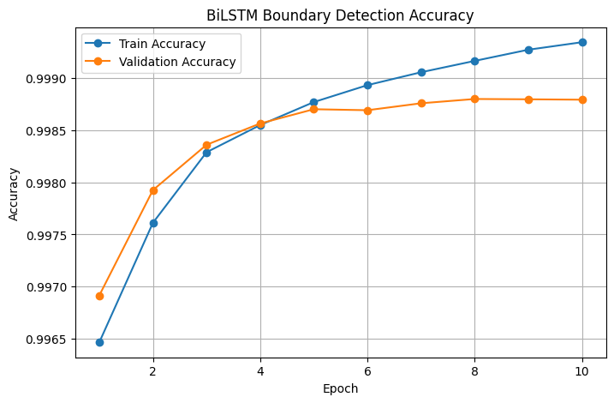
Hybrid Pipeline
Project title

Slide 26
Result Table
Model | F1-Score | Exact Match | CER | Accuracy
Rule-Based System | 0.68 | 0.41 | 0.38 | 69.2%
RNN (Baseline) | 0.719 | 0.45 | 0.35 | 71.0%
BiLSTM | 0.806 | 0.53 | 0.29 | 74.6%
Seq2Seq | 0.781 | 0.493 | 0.32 | 72.8%
Seq2Seq + Attention | 0.812 | 0.561 | 0.27 | 76.4%
Proposed Pipeline (Ph.I) | 0.826 | 0.612 | 0.23 | 78.9%
UMT5 (Fine-tuned) | 0.84 | 0.51 | 0.20 | 72.5%
mT5 (Fine-tuned) | 0.86 | 0.69 | 0.18 | 74.1%
ByT5 (Fine-tuned) | 0.83 | 0.64 | 0.21 | 75.0%
Gemma-3-4b-it (Fine-tuned) | 0.71 | 0.58 | 0.26 | 50.3%
Hybrid Pipeline | 0.88 | 0.78 | 0.12 | 84%
Project title

Slide 27
Alignment with SDG Goals
SDG | Quality | Contribution
SDG 4 | Quality Education | Computational access to classical Sanskrit Ayurvedic texts for students and researchers.
SDG 3 | Good Health and Well-being | Digital preservation of Ayurvedic medical knowledge supports traditional healthcare research.
SDG 9 | Industry, Innovation and Infrastructure | Lightweight, reusable open NLP infrastructure for low-resource languages.
SDG 10 | Reduced Inequalities | Democratizes Sanskrit NLP — no high-end GPU required.
SDG 11 | Sustainable Communities | Preserves India's intangible cultural and literary heritage.
Project title

Slide 28
Limitations
Dataset size — ∼15,000 samples; small for full transformer training.
Narrow domain — only specific texts can be covered.
Word-level focus — no sentence-/discourse-level disambiguation.
Long compounds still degrade significantly.
Rule engine coverage — Paninian rules implemented are partial, not exhaustive.
Annotation bottleneck — manual expert linguist effort limits dataset growth
Project title

Slide 29
Future Works
Corpus Expansion – Increase annotated Ayurvedic Sanskrit datasets for better generalization and reduced OOV errors.
Full Disambiguation Framework – Use sentence-level contextual understanding for improved ambiguity resolution.
End-to-End Transformer Fine-Tuning – Extend fine-tuning from word-level to sentence and discourse-level learning.
Extension to Other Sanskrit Domains – Adapt the framework to philosophical, poetic, and legal Sanskrit texts.
Downstream NLP Integration – Integrate Sandhi splitting into parsing, translation, and knowledge graph pipelines.
Multimodal and Cross-lingual Transfer – Explore transfer learning from morphologically rich languages like Tamil and Finnish.
Lightweight Model Deployment – Apply compression and quantization for mobile and edge-device deployment.
Active Learning and Annotation Tools – Develop semi-automatic annotation systems to accelerate dataset creation.
Project title

Slide 30
Publications
Phase I paper – Awaiting approval – ICT4SD2026
Phase II Paper – Awaiting CFP – KalingaConf2026
Project title

Slide 31
References
Aralikatte, R., Gantayat, N., Panwar, N., Sankaran, A., & Mani, S. (2018). Sanskrit Sandhi splitting using seq2(seq). In Proceedings of the 2018 Conference on Empirical Methods in Natural Language Processing (EMNLP).
Bhat, S., & Premjith, B. (2025). Transformer-based semantic analysis for Sanskrit texts. Neural Computing and Applications.
Dave, S., Singh, A., Lall, P., & Sahoo, S. (2020). Neural compound-word (Sandhi) generation and splitting in Sanskrit language. arXiv preprint arXiv:2010.12940.
Hellwig, O., & Nehrdich, S. (2019). Sanskrit word segmentation using character-level recurrent and convolutional neural networks. In Proceedings of COLING 2019.
Kakwani, D., Kunchukuttan, A., Golla, S., et al. (2022). IndicBART: A pre-trained model for Indic natural language generation. In Findings of ACL 2022.
Reddy, V., Krishna, A., Sharma, V., Gupta, P., & Goyal, P. (2018). Building a word segmenter for Sanskrit overnight. In Proceedings of the International Conference on Language Resources and Evaluation (LREC 2018).
Sandhan, J., Singha, A., Adhikary, N., et al. (2023). SanskritShala: A neural Sanskrit NLP toolkit with web-based interface. In Proceedings of ACL 2023.
Sen, S., Hasanuzzaman, M., Ekbal, A., Bhattacharyya, P., & Way, A. (2022). ByT5 model for massively multilingual grapheme-to-phoneme conversion. Transactions of the Association for Computational Linguistics (TACL).
Sreedeepa, H. S., et al. (2024). Deep learning methods for Sanskrit language processing: A review. Journal of Computational Linguistics.
Varshini, R., & Nair, J. (2023). Natural language processing for Ayurvedic Sanskrit texts: A survey. Procedia Computer Science.
Project title

